Slide 1



Songs Records Analysis
Presentation By Group 1
Date：2024.07.06
——coharvesterministry.com

Slide 2

01.
Introduction
02.
Data Cleaning
CONTENTS
03.
Trends and Patterns
04.
Conclusion and Recommendation

Slide 3

Introduction
The data consists of songs records from the year 1920 to 2010.
It has 10,000 rows and 8 columns
Objectives:
To clean the data
To identify trends and patterns in the data
To make conclusions from insight drawn from the data

Slide 4



Data Cleaning
Inconsistencies Observed:
Number of songs with incorrect year released was
Number of songs with loudness greater than or equal to zero was
Number of songs with a tempo of zero was
5,309
6
27
Action:
Dropping of all inconsistent data.
Shape of cleaned Data was and
4,674 rows
8 columns
Notes:
# Songs with year of release equal to zero are erroneous
# The loudness of a song must be less than zero. The closer the value is to zero, # the louder the song.
# The tempo of a song cannot be zero

Slide 5
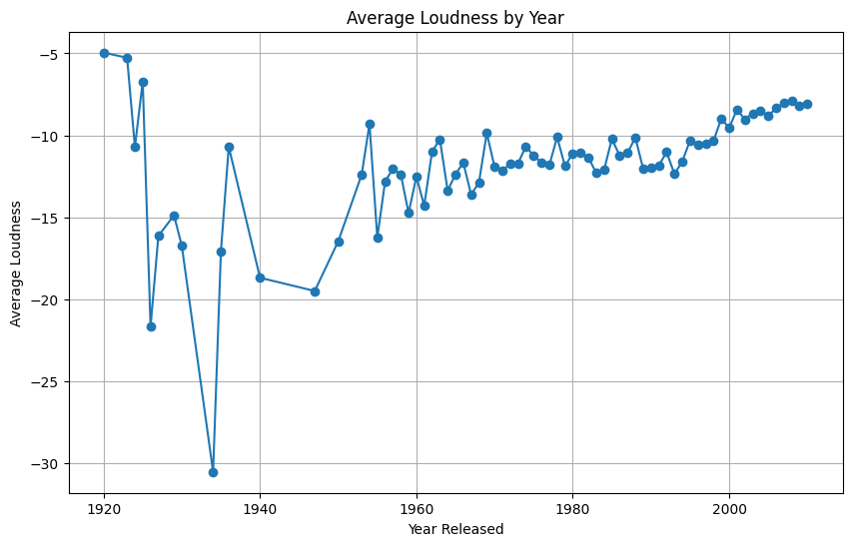
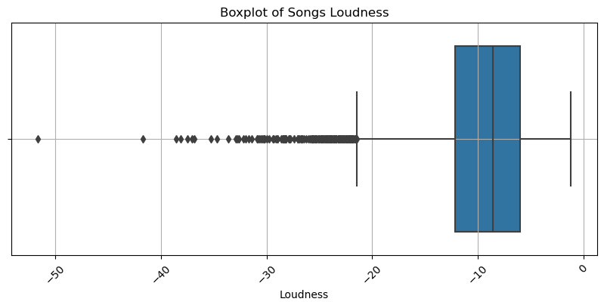
Trends and Pattern
Add a short description

Slide 6
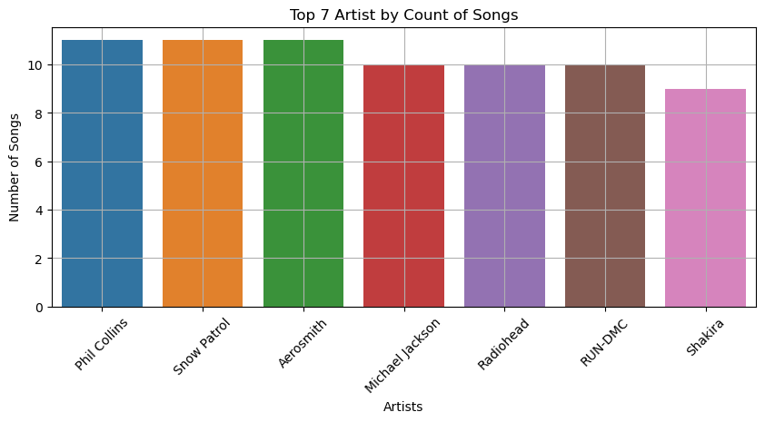
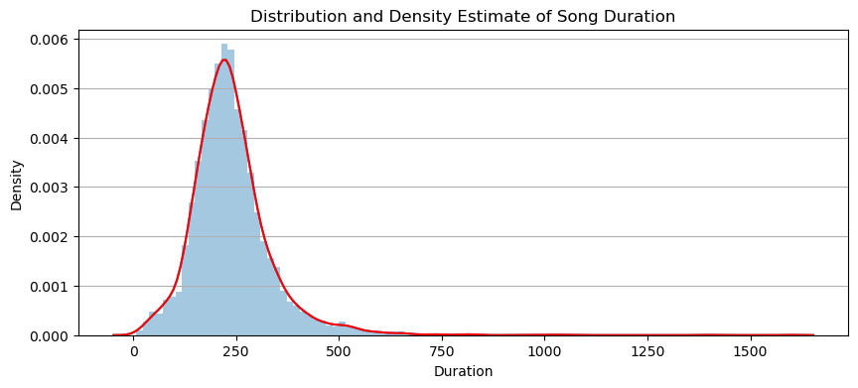
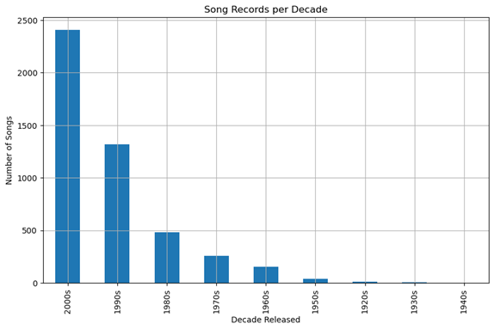
Trends and Pattern
Add a short description
11
11
11
10
10
10
9
Notes:
On the right we Use Kernel Density Estimate (KDE)

Slide 7

Next step work plan
CONCLUSION
Average Loudness has increased over the years
The number of songs released per decade has maintained an upward trend.
A large proportion of songs are loud as shown by the boxplot.
The distribution of song duration is right skewed, indicating that large proportion of the songs have short duration.

Slide 8
Next step work plan
RECOMMENDATION
Attention to detail is required during data imputation to avoid errors.

Slide 9


